Slide 1
Blitztheblues
World Mental Health Day
Tough Talking and Truth Telling for Loving Kindness
10th October, 2020
Bec Enders: Huon Valley Mayor
Rodney Dillon: Aboriginal elder & Amnesty International
Sergeant Andrew Fogarty: Tasmanian Police Huonville
Rev. Ian Cartmel: Huonville Community Church
Ruth Parsons: Co-Ordinator of GROW Tasmania
Sue Carlyon: RN, Educator, and Director of Blitztheblues
The DayStar Duo – Rob and Ailsa Nicholls

Slide 2
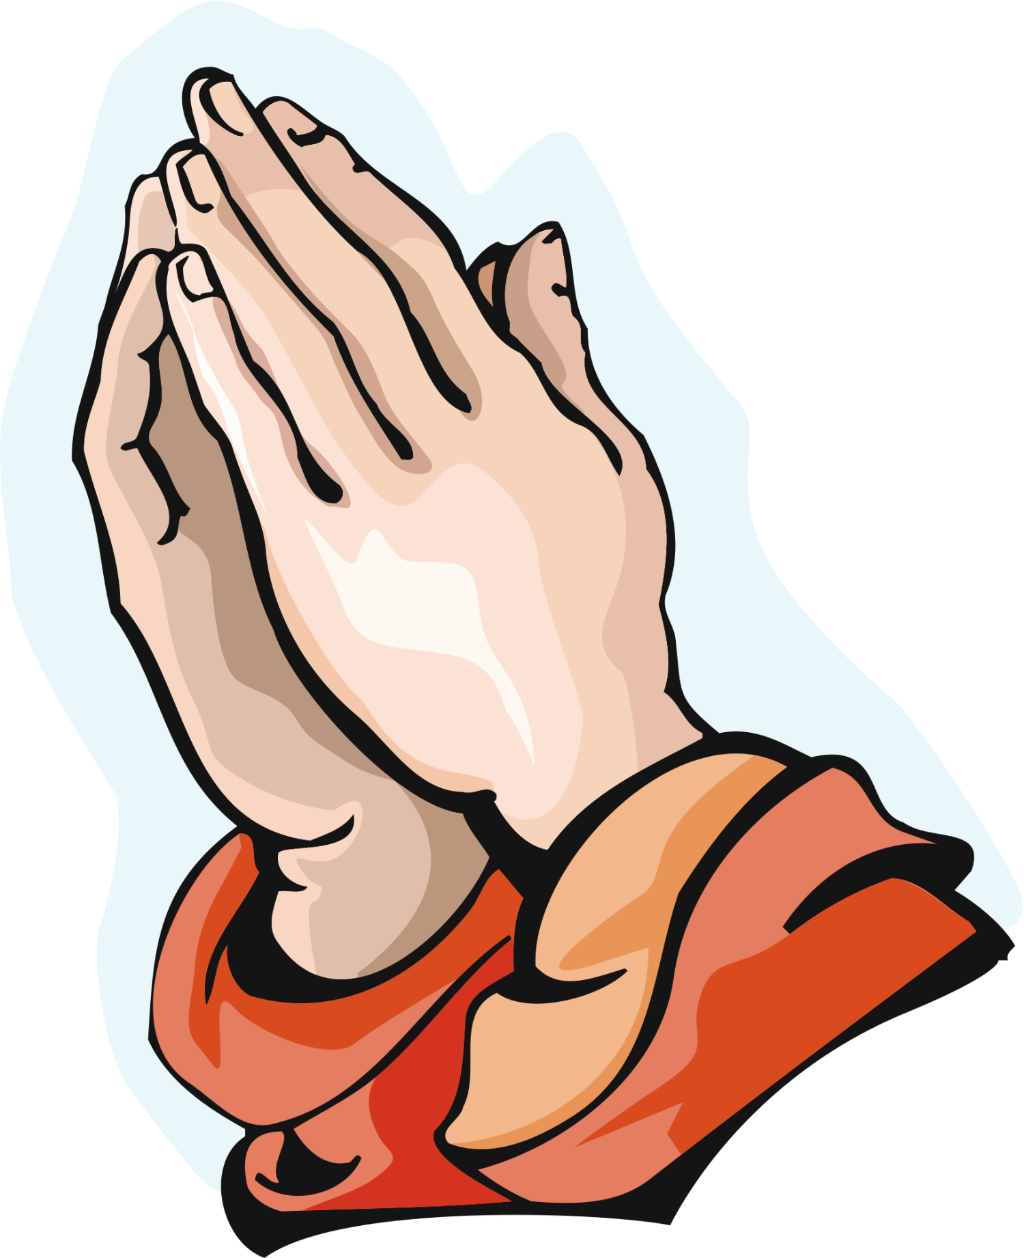
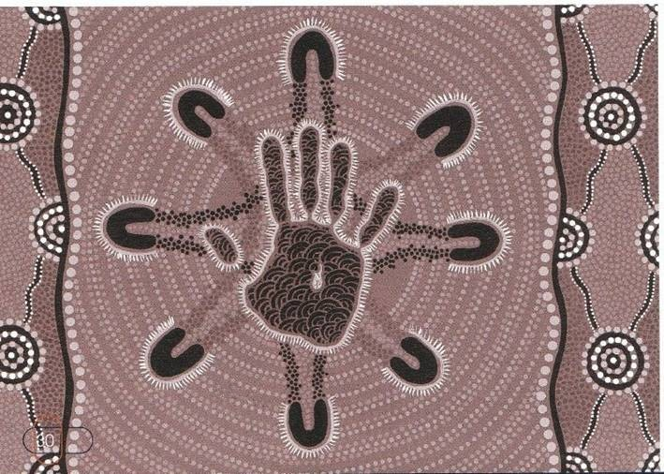
Acknowledgements
I acknowledge God in our midst, and I acknowledge the traditional custodians of the land and rivers of Australia. I also acknowledge the ancestors of each one of us – those who have contributed to making us who we are today.

Slide 3
Religious and Scientific Discrepancies
IN THE BEGINNING Southern Hemisphere
Approx. 65,000++yrs Aboriginal Australians
carbon dated scientifically
Northern Hemisphere approx. 250 Tribes + over 600 languages
Approx. 5 - 6,000 Yrs spiritual
Adam & Eve
religious
1440BC Moses & The Ten Commandments
29AD Jesus & the 2 Love Commandments FIRST CENTURY
- - - - - - - - - - - - - - - - - - - - - - - - - - - - - - - - - - - - - - - - - - - - - - - - - - - - - - - - - - - - - - - - - - - - - - - - - - - - - - - - - - - - - - - - - - - - - - - - - - - - - - - - - - - - - - -
religious & spiritual
380 AD Roman Catholicism spiritual
612 AD Islam 1788 British invasion
The SOLUTIONS = TRUTH, RECONCILIATION, UNITY & LOVING KINDNESS religion & colonization
21st Century chaos 21st Century chaos
CLOSING the GAP
© S. J. Carlyon October 2020

Slide 4
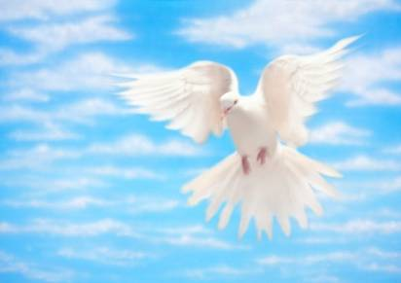
Knowledge = Physical, Emotional, Mental, Spiritual, Social, Environmental, etc. =
SPIRITUAL CONNECTEDNESS
A The Creator, Spirit of Life
B The Oneness of God
C The Godhead = The Father, Jesus the Son & The Holy Spirit
A
B
C
Young Adult
Middle Age
M
Adult
1.
F
Pre Teens
Teens
10 Years
Old Age
6 Years
12 Months
3 Score + 10
2.
RIP
Birth
Death
Formative Years -
Sexual Awareness -
Search for Meaning
- Self Actualization
The JOURNEY of LIFE S. J. Carlyon 2006

Slide 5
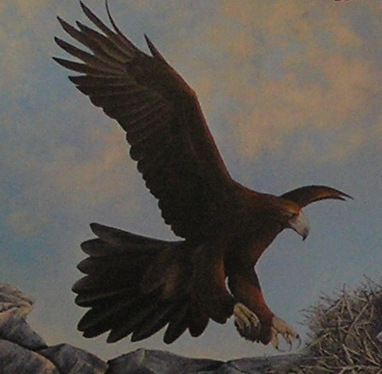
The Fear Factor
“God has not given us a spirit of fear, but one of power, and of love, and of a sound mind.” 2 TIMOTHY 1:7, NT. Paul of Tarsus 48AD

Slide 6
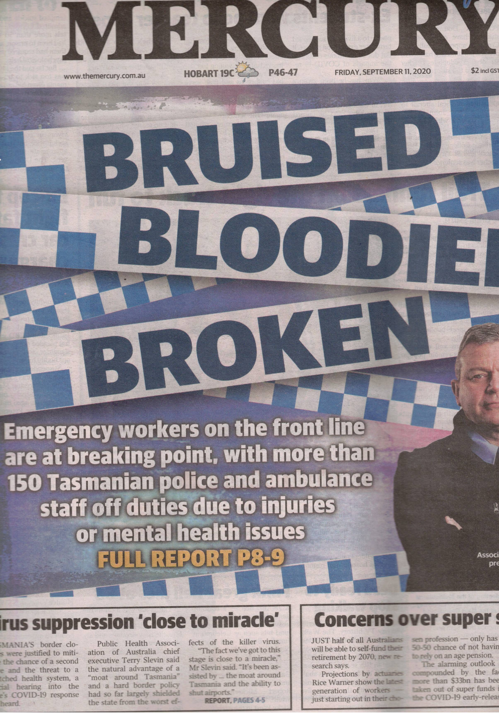
D

Slide 7


Spi
r
I
t
1. THOUGHTS
5. REACTIONS
2. WORDS
SELF-CONTROL
LOVE
LIFE’S EXPERIENCES
JOY
GENTLENESS
FAMILY
OPPORTUNITIES
Self
PEACE
CULTURE
FAITHFULNESS
PATIENCE
EDUCATION
KNOWLEDGE
GOODNESS
RELIGION
KINDNESS
OTHER influences
OTHER influences
4. ACTIONS
3. ATTITUDES
The Fruit of the Spirit
© S. J. Carlyon October 2020

Slide 8
Biblical definition of LOVE
LOVE is kind and patient
never jealous, proud or rude.
LOVE isn’t selfish or quick tempered.
It doesn’t keep a record of wrongs that others do.
LOVE rejoices in the truth, but not in evil.
LOVE is always supportive, loyal, hopeful and trusting.
LOVE never fails.
(13) For now there are faith, hope and love.
But of these three, the greatest is LOVE
1 Corinthians 13:4-8 & 13, New Testament

Slide 9
Marie Curie 1867 - 1934
“We cannot hope to build a better world
without improving the individuals.
To that end each of us must work for our own improvement
and, at the same time,
share a general responsibility for all humanity,
our particular duty being to aid those to whom we think we can be most useful”

Slide 10

RECONCILIATION
Acknowledging our common humanity & our frailties
Identifying the cause of the conflict
Apologizing or forgiving as appropriate
Restoring or establishing friendly relations where possible, and if prudent
Accepting differing opinions that allows for unity and not division

Slide 11

Mental Health and wellbeing through Spiritual Insight
There is a physical body, and there is a spiritual body
1 CORINTHIANS, 15:44, NT

